Slide 1
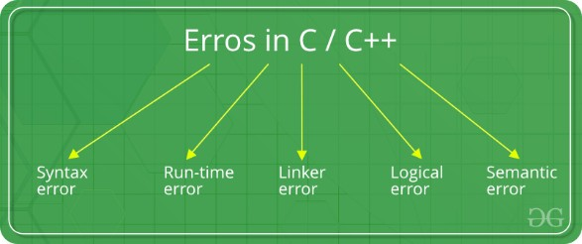
Types of Errors

Slide 2

Syntax Errors
Syntax errors: Errors that occur when you violate the rules of writing C/C++
syntax are known as syntax errors.
This compiler error indicates something that must be fixed before the code can be compiled. All these errors are detected by
compiler and thus are known as compile-time errors.
Most frequent syntax errors are:
• Missing Parenthesis (})
• Printing the value of variable without declaring it
• Missing semicolon like this

Slide 3
Syntax Errors-Example
#include<stdio.h> void main()
{ int x = 10; int y = 15;
printf("%d", (x, y)) // semicolon missed
}
Error:
error: expected ';' before '}' token

Slide 4
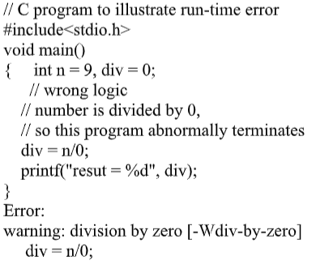
Run-time Errors
Errors which occur during program execution(run-time) after successful compilation are called run-time errors.
One of the most common run-time error is division by zero also known as Division error.
These types of error are hard to find as the compiler doesn’t point to the line at which the error occurs.

Slide 5
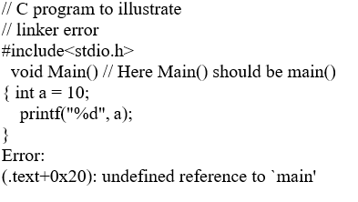
Linker Errors
These error occurs when after compilation we link the different object files with main’s object using Ctrl+F9 key(RUN).
These are errors generated when the executable of the program cannot be generated.
This may be due to wrong function prototyping, incorrect header files.
One of the most common linker error is writing Main() instead of main().

Slide 6
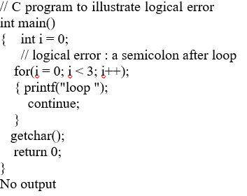
Logical Errors
On compilation and execution of a program, desired output is not obtained when certain input values are given.
These types of errors which provide incorrect output but appears to be error free are called logical errors.
These are one of the most common errors done by beginners of programming.
These errors solely depend on the logical thinking of the programmer and are easy to detect if we follow the line of execution and determine why the program takes that path of execution

Slide 7
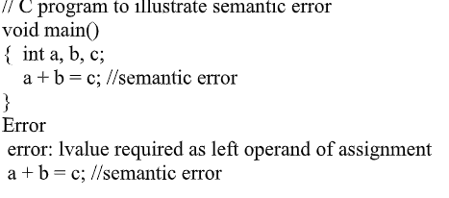
Semantic errors
This error occurs when the statements written in the program are
not meaningful to the compiler.

